Slide 1
Environmental Justice Thriving Communities Technical Assistance Center (EJ TCTAC) Program
Raksha Vasudevan, PhD
rvasudevan@icma.org
Senior Program Manager
International City/County Management Association

Slide 2
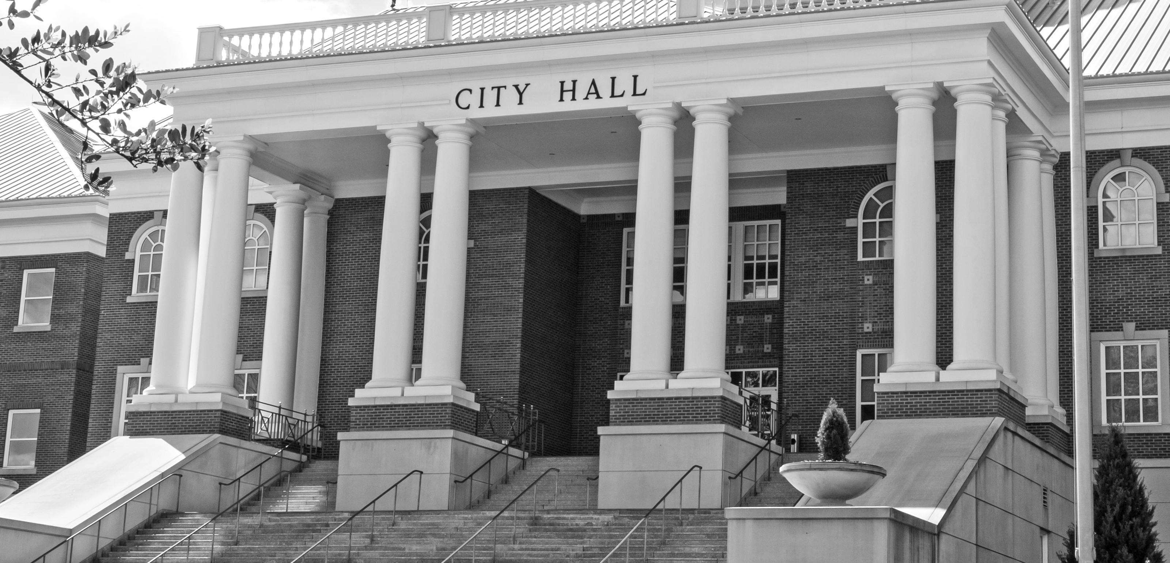
International city/county management association
OUR mission
To create excellence in local governance by developing and fostering professional local government management worldwide.
OUR VISION
We are the premier association of professional local government leaders building sustainable communities to improve lives worldwide.
Notes:
ICMA is a more than 100 year old organization with a legacy of the development of professional local government, including the fostering of generations of managers grounded in ethics, leadership and the promotion of leading practices
Over 12,000 members representing all 50 states and over 30 countries (Nigeria, Japan, Canada, Australia, New Zealand, UK, just to name a few). ICMA also has 30 international city management affiliate associations

Slide 3








What We Do
Membership organization
Education and Training
All things local government
Peer to Peer Engagement
In house topical expertise on brownfields, renewable
(solar, wind) energy
Consulting and
Technical Assistance
Expertise working with small
and rural communities
Research

Slide 4
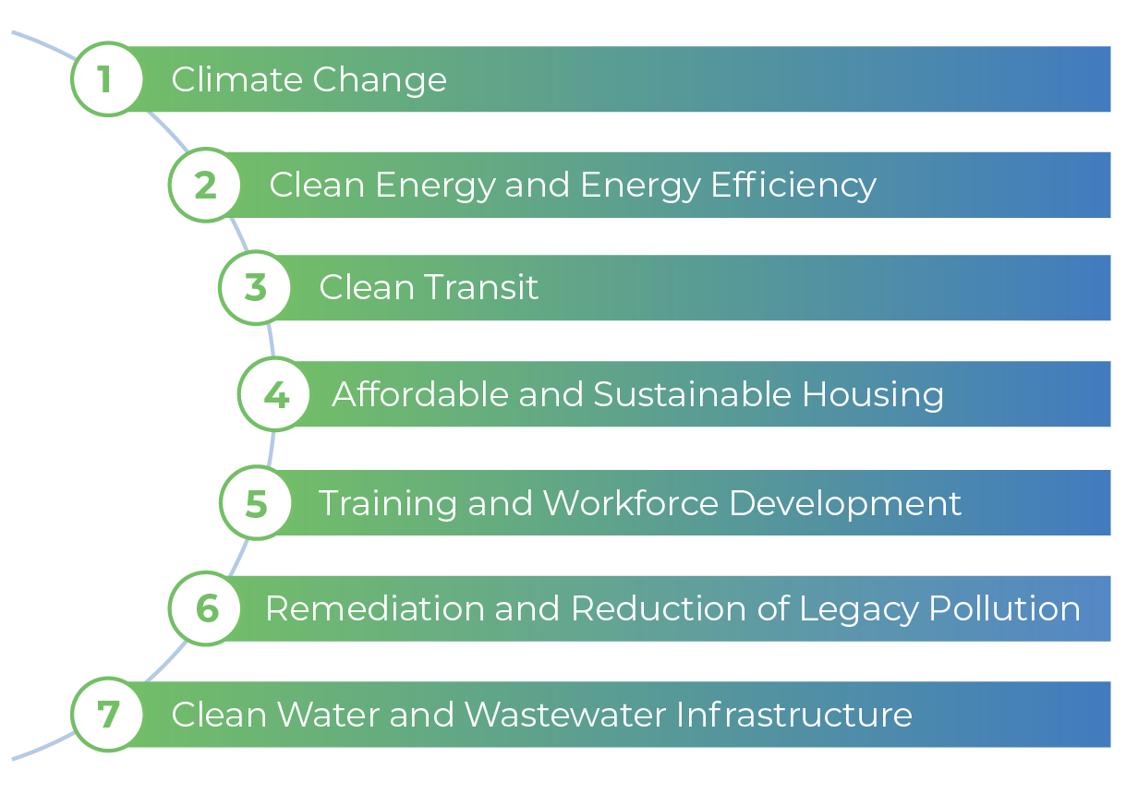
Background
The Justice40 Initiative, launched by Executive Order in 2021, mandates that 40% of the overall benefits of certain federal investments flow to communities that have been marginalized, underserved, and overburdened by pollution and climate change.
It impacts the direction of tens of billions of dollars in funds from legislation including the Inflation Reduction Act and Bipartisan Infrastructure Law.

Slide 5
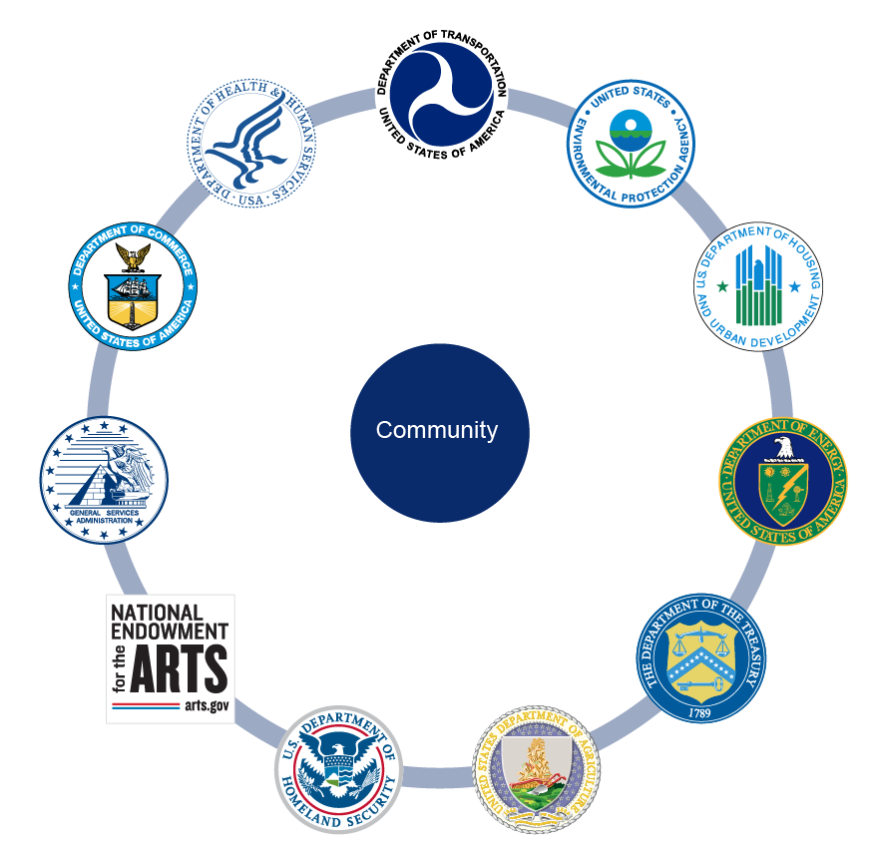
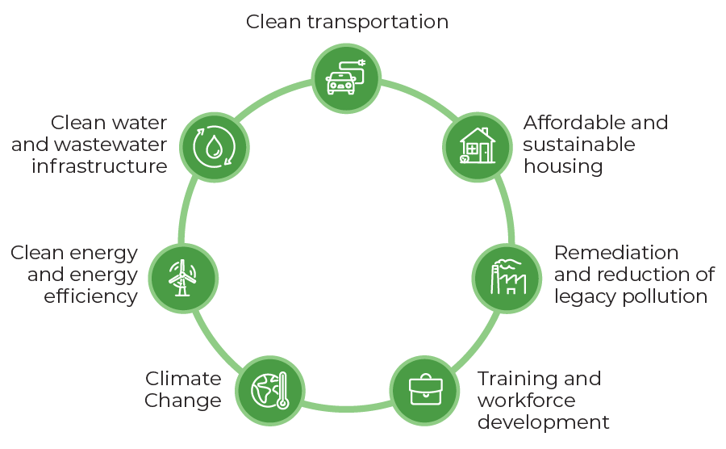
Thriving Communities Network
The Thriving Communities Network (TCN) is a federal interagency effort to coordinate place-based technical assistance and capacity-building resources for urban, rural, and Tribal communities experiencing a history of economic distress and systemic disinvestment.
Through TCN, federal partners at USDA, EPA, HUD, DOC, DOT, FEMA, GSA, HHS, and DOE commit to coordinating and collaborating across a set of TA programs and engaging their regional and field staff who often serve
as key points of contact for communities.

Slide 6




EJ TCTACs
The EJ TCTAC Program is part of the Federal Thriving Communities Network Initiative that is working towards a holistic government-wide framework for providing technical assistance and capacity building resources to those most in need to improve and foster thriving communities throughout
the country.
Identify grant opportunities.
Prepare grant applications and manage grant funding.
Build capacity to effectively engage with decisionmakers.
Develop collaborative community-based partnerships.
For more information, please visit: www.ejtctac.org.

Slide 7
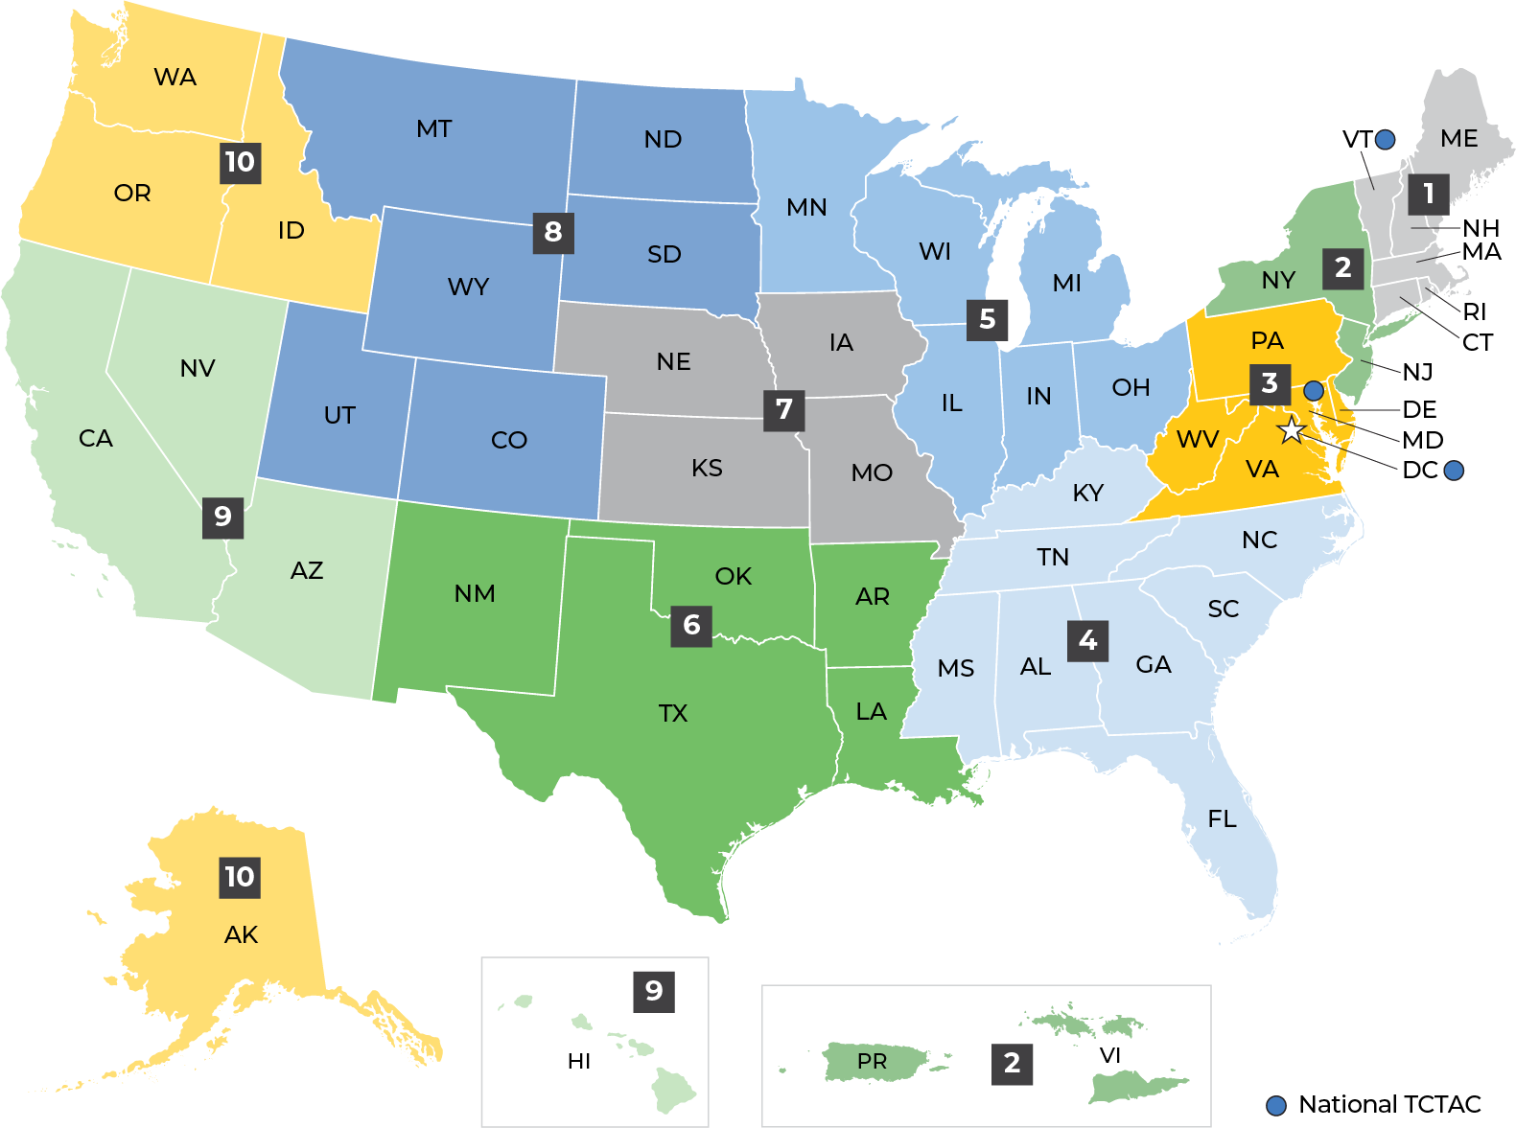
EJ TCTAC Regions
There are 18 TCTACs:
3 National TCTACs
15 Regional TCTACs
Region 1 CT, ME, MA, NH, RI, and VT
Region 2 NJ, NY, Puerto Rico, the U.S. Virgin Islands
and 8 federally recognized Indian Nations
Region 3 DE, DC, MD, PA, VA, WV and 7 federally
recognized tribes
Region 4 AL, FL, GA, KY, MS, NC, SC, and TN
Region 5 IL, IN, MI, MN, OH, and WI
Region 6 AR, LA, NM, OK, and TX
Region 7 IA, KS, MO, and NE
Region 8 CO, MT, ND, SD, UT, and WY
Region 9 AZ, CA, HI, NV, American Samoa, Commonwealth
of the Northern Mariana Islands, Federated States
of Micronesia, Guam, Marshall Islands, and
Republic of Palau
Region 10 AK, ID, OR, WA and 271 native tribes

Slide 8
National and Regional Centers
(based on designated EPA Regions)
NATIONAL
International City/County Management Association (ICMA)
National Indian Health Board (NIHB)
Institute for Sustainable Communities (ISC)
REGIONAL
REGION 1* University of Connecticut | REGION 6 Deep South Center for Environmental Justice New Mexico State University
REGION 2 West Harlem Environmental Action, Inc. Inter-American University of Puerto Rico-Metro Campus | REGION 7 Wichita State University
REGION 3 National Wildlife Federation | REGION 8* Montana State University Mountains and Plains Thriving Communities Collaborative
REGION 4 Research Triangle Institute Deep South Center for Environmental Justice | REGION 9 University of Arizona San Diego State University
REGION 5 Blacks in Green University of Minnesota | REGION 10 Willamette Partnership University of Washington
Region 1* ISC providing interim coverage and Region 8* ICMA providing interim coverage.

Slide 9
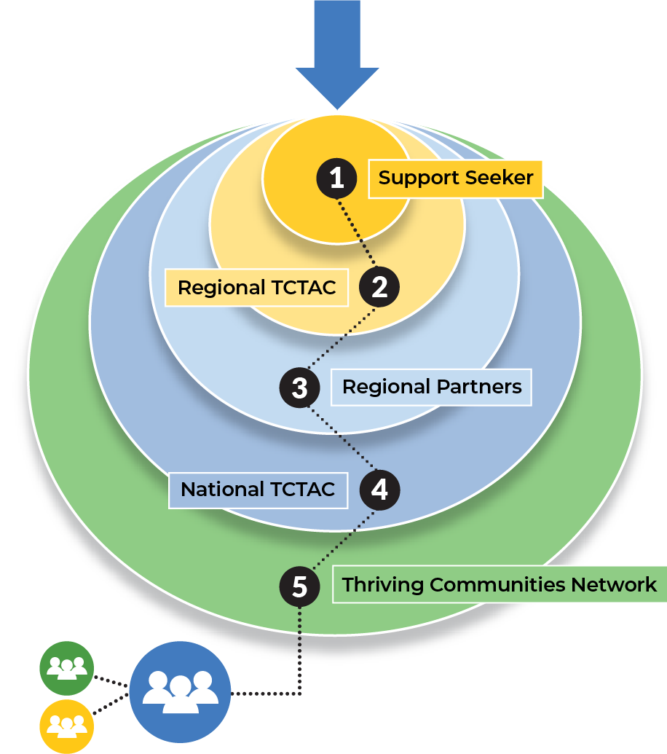
How Nationals and Regionals Connect
Support seeker from an eligible CBO, tribal government, or
state/local government requesting expertise in federal grant applications, proposal writing, and grant management for environmental justice projects
Regional TCTAC prepared to provide technical assistance in collaboration with an extensive regional network of partners
Regional Partnerships with over 160 organizations nationwide ready to support regional efforts in building capacity on
the ground
National TCTAC coordinating with regional centers and partners through resource-sharing and networking opportunities
Thriving Communities Network expanding our program's access to a range of technical assistance providers

Slide 10




ICMA National TCTAC Team: local and tribal governments
Well-established relationships with local government officials, practitioners, and tribal leaders
Long history of working with small (urban and rural) communities
Experience with federal grant processes
Experience with grant review
Extensive experience delivering technical assistance in the form of workshops, peer networks, and one-to-one support

Slide 11
EJ TCTACs
The EJ TCTAC Program is part of the Federal Thriving Communities Network Initiative that is working towards a holistic government-wide framework for providing technical assistance and capacity building resources to those most in need to improve and foster thriving communities throughout
the country.
Identify grant opportunities.
Prepare grant applications and manage grant funding.
Build capacity to effectively engage with decisionmakers.
Develop collaborative community-based partnerships.
For more information, please visit: www.ejtctac.org.

Slide 12

Email tctac@icma.org
-OR-
Call us at 1-(855)-EJTCTAC
-OR-
Scan the QR code to visit to access our intake form!

