Slide 1
Funding Environmental Action at Your Local Library
February 27, 2025

Slide 2
Agenda
Introduction
Belfast, ME
Mt. Vernon, WA
Q&A
Next Steps

Slide 3
ICMA National TCTAC Team: Local and Tribal Governments
Well-established relationships with local government officials, practitioners, and tribal leaders
Long history of working with small (urban and rural) communities
Experience with federal grant processes
Experience with grant review
Extensive experience delivering technical assistance in the form of workshops, peer networks, and one-to-one support

Slide 4
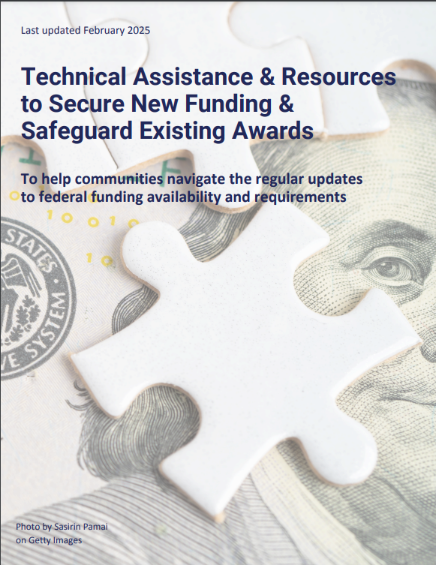
ICMA National TCTAC Team: Resources

Slide 5
One immediate opportunity – due tomorrow!

Slide 6
Funding Environmental Action at Your Local Library
February 27, 2025

Slide 7
Our Speakers
Brenda Harrington
Assistant Director
Belfast Free Library
Sarah Kirn
Participatory Science Strategist
Gulf of Maine Research Institute
Jill Boudreau
Mayor Emerita
Mount Vernon, WA

Slide 8
Next Steps
Look out for our follow up email!
Sign up for Technical Assistance: https://tctac.icma.org/
Sign up for our next webinar in March: How to Meaningfully Engage with Community Stakeholders

Slide 9
THANK YOU!
Thank you!

